Slide 1
Multimedia Systems
Presented by : Robinhood Khadka

Slide 2
course Content
Chapter 1: Multimedia Introduction (4 Hrs)
Chapter 2: Sound and Audio (4 Hrs)
Chapter 3: Image and Graphics (4 Hrs)
Chapter 4: Video and Animation ( 5 Hrs)
Chapter 5: Data Compression ( 8 Hrs)
Chapter 6: Optical Storage Media ( 5 Hrs)
Chapter 7: Computer Tech and MOS ( 5 Hrs)
Chapter 8: Documentation, Hypertext and MHEG( 5 Hrs)
Chapter 9: Multimedia Communication System (5 Hrs)

Slide 3
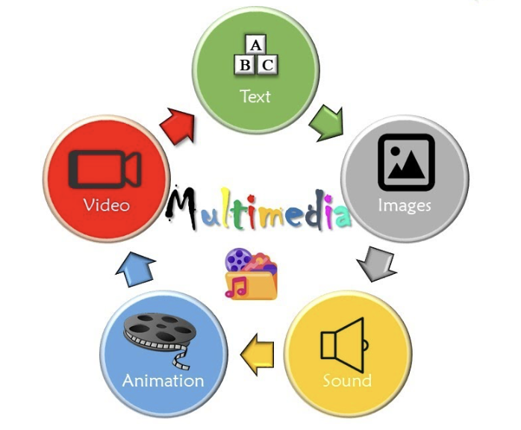
Chapter 1: Multimedia introduction
Elements of Multimedia / Building Blocks of Multimedia
1. Text:
Text is still a primary way to transmit information
Most impactful means of communication
By leveraging various text types, sizes, colors, and background hues, its potential is limitless

Slide 4
Chapter 1 : contd…
2. Image/ Graphics
Image is a photograph, drawing/sketch, graphic, or any other visual representation of an idea/concept.
They often accompany text to visually enhance and reinforce the conveyed ideas
Images are static in nature as against dynamic videos
Images are created and stored in electronic form
Images may also include graphics which are visual designs (logos, design layouts, graphic data, etc.
3. Video
Video involves the use of video technology and refers to the ‘recording – processing – copying – reproducing
Video is a visual multimedia application that combines a sequence of images to form moving pictures.
Video can have an impact on websites and on social media platforms in a very unique and powerful way.
Social media sites like Facebook, X, and LinkedIn all provide video integration capabilities

Slide 5
Chapter 1 : contd…
4. Audio
Audio, in the context of multimedia, refers to the files and devices associated with the ‘recording – processing – storing – delivery’ of audible sounds (voice, music, noise, etc.)
Stored as audio files in multiple formats (WAV, MP3, etc.), and can be delivered through speakers or headphones.
Sound plays a vital role in enhancing the design of your website and social media platforms.
5. Animation
Animation, Refers to the technique involving the rapid display of a sequence of progressive, static images
Animation is a series of images put together to give the effect of movement.
Usually at 24 frames per second, to produce the illusion of motion
Used to bring an idea/story/image to life.
In multimedia, 2D and 3D digital animation is used

Slide 6
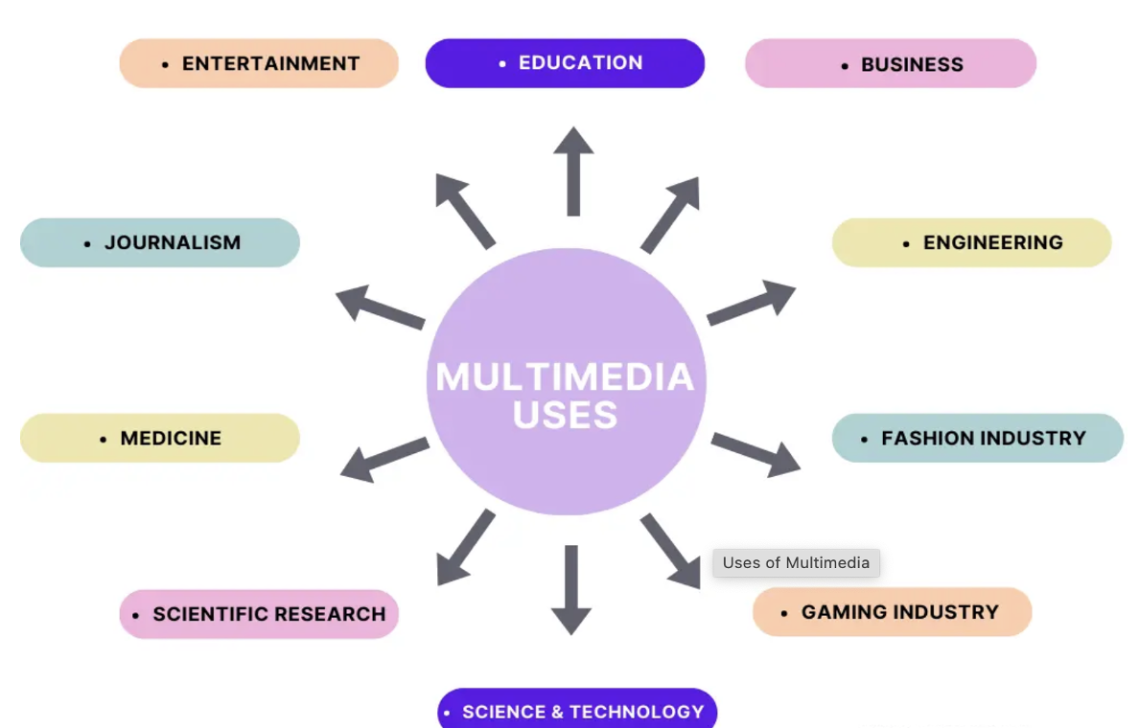
Application Areas/ Uses

Slide 7
Application Areas/ Uses
Uses of Multimedia in Education
Schools are approaching the modern multimedia methods of education where Toddlers , young ones are helped in studying new topics with the help of games, interactive puzzles, audio, videos, and stories.
This is helping the new ones immensely and can be seen in the new generation as they are becoming very smart to learn new subjects and topics far more conveniently than we used to do.
Modern techniques included in multimedia can help students to learn with the help of charts, diagrams, info-graphics, and flowcharts.

Slide 8
Application Areas/ Uses
2. Uses of Multimedia in Entertainment
The remarkable advancement in the entertainment industry is due to the Multimedia Technology
The uses of multimedia is more often used in the entertainment industry which is mainly used in creating movies, short films, 2D animations, 3D animations and VFX.
This technology is needed in all mode of entertainment like radio, TV, online gaming, video on demand etc.

Slide 9
Application Areas/ Uses
3. Uses of Multimedia in Science and Technology
Medical services are grown drastically with the development of multimedia.
Medical Doctors/Students practices surgery methods via simulation prior to actual surgery.
Besides this, multimedia is also used in diagnosing the diseases
Simulations can predict the behavior/pattern of diseases.

Slide 10
Application Areas/ Uses
4. Uses of Multimedia in Business
Multimedia is considered a very powerful tool that is used in communication and interaction with clients.
This multimedia is found in enhancing presentation skills and always gives a realistic approach to the business with the data and information presented in the presentation slides with the use of images, text, videos, animations, etc.
Use of different statistical tools, charts provide in-depth analysis of business sectors providing the clear picture.

Slide 11
Application Areas/ Uses
5. Uses of Multimedia in Journalism
6. Uses of Multimedia in Engineering
7. Uses of Multimedia at Home
8. Uses of Multimedia in Scientific Research
9. Uses of Multimedia in Gaming Industry
10. Uses of Multimedia in Engineering

Slide 12
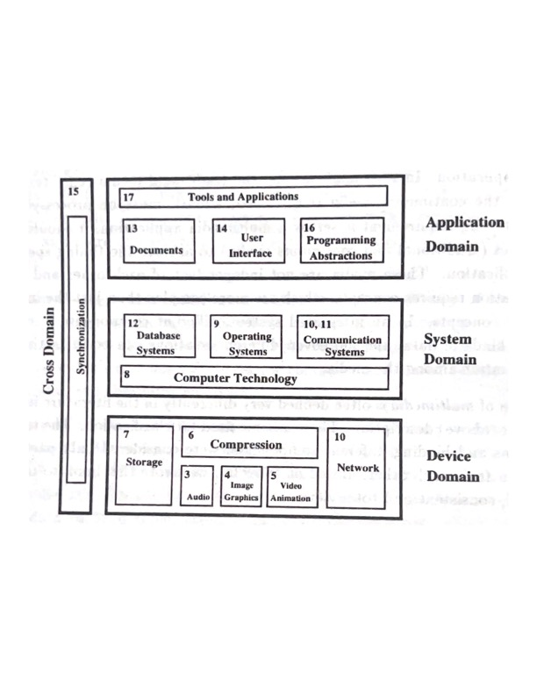
Global Structure
Device Domain
System Domain
Application Domain
Cross Domain

Slide 13
1. Device Domain
It deals with interaction between multimedia application and multimedia devices such as AGP(Accelerated Graphics Port) Card, Sound Card etc.
Basic concepts for the processing of digital audio and video data are based on digital signal processing.
Different methods for the processing of image, graphics and animation are described.
Networks, with their higher bandwidth and capability of transmitting all media types have led to networked multimedia system.

Slide 14
2. System domain
The interface between the device domain and the system domain is specified by the computer technology.
To utilize the device domain, 3 services exist which are mostly implement in software.
1. Operating System: Serves as a interface between a computer hardware and system software.
Provides services relating to computer resources such as processor, main memory, secondary memory, I/O device etc.
2. Database System: The database system allows a structured access to data and management of large databases.
3. Communication System: Responsible for data transmission according to the timing and reliability requirement of the networked multimedia application

Slide 15
3. Application domain
The Services of the system domain are offered to the application domain through proper programming abstractions.
For document handling, a set of structured information(document) which are represented in different media and generated or recorded at the time of presentation is present in thin domain
These functions of document handling and other applications are presented to the user through a user interface

Slide 16
4. Cross domain
It mainly deals with the synchronizing signals that arise during communication between two parties or other domains.

Slide 17
Multimedia
Multi: Many, Multiple
Medium: Means of communication
General Defination:
“Multimedia is a field concerned with the computer controlled integration of Text, Graphics, Images, Moving Images(Videos), Animation, Audio and any other media where every type of information can be represented, stored, processed and transmitted digitally”

Slide 18
Mediums
They are categorized as :
Perception Medium
Representation Medium
Presentation Medium
Storage Medium
Transmission Medium
Information Exchange Medium

Slide 19
1. Perception Medium
Perception media help human to sense their environment. The central question is how human perceive information in a computer environment? The answer is through seeing and hearing.
Seeing: For the perception of information through seeing the usual such as text, image and video are used.
Hearing: For the perception of information through hearing media such as music, noise and speech are used.

Slide 20
2. Representation medium
Representation media are defined by internal computer representation of information. The central question is how the computer information is coded? The answer is that various format are used to represent media information in computer.
Text, character is coded in ASCII code
Graphics are coded according to CEPT or CAPTAIN video text standard.
Image can be coded as JPEG format
Stream of audio can be represented using PCM
Audio video sequence can be coded in different TV standard format (PAL, NTSC, SECAM and stored in the computer in MPEG format)

Slide 21
3. Presentation medium
Presentation media refer to the tools and devices for the input and output of the information. The central question is, through which the information is delivered by the computer and is introduced to the computer?
Output media: Paper, screen and speaker are the output media.
Input Media: Keyboard, mouse, camera, microphone are the input media.
Digital Media: Soft copy presentation.
Paper Media: Hard copy presentation.

Slide 22
4. Storage Meduim
Storage Media refer to the data carrier which enables storage of information. The central question is, how will information be stored?
The answer is hard disk, CD-ROM, Floppy, Micro- film, printed documents, digital storage etc.

Slide 23
5. Transmission Medium
Transmission Media are the different information carrier that enables continuous data transmission. The central question is, over what will the information be transmitted?
Information is transmitted over network either by using wired or wireless connection.
Wired connection can be twisted pair, coaxial cable, optical fiber cable etc.
Wireless connection can be satellite connection or radio link connections etc.

Slide 24
6. Information exchange medium
Information exchange media includes all information carrier for transmission, i.e. all storage and transmission media.
The central question is, which information carrier will be used for information exchange between different places?
The answer is combine uses of storage and transmission media. E.g. Electronic mailing system
Information can flow through intermediate storage media, where the storage medium is transported outside of computer networks to the destination, through direct transmission using computer networks, or through combined usage of storage and transmission media.

Slide 25
Technical challenges for multimedia systems
1. Storage/Amount of Data:
While dealing with different multimedia, obviouisly there is an ever increasing demand for the storage medium.
Multimedia files are large, requiring significant storage capacity
The system must be scalable to support large audiences specially for services like video streaming. E.g. Netflix, Amazon
2. Timing Requirements/ Real Time Performance:
The avaliability of RTS (Real Time System), for live streaming or video conferencing, low-latency communication is essential.
Minimizing delays across networks while maintaining high quality is a significant challenge
Packets of Data must be handled accordingly during transmission through different mediums

Slide 26
Contd..
3. Integration Requirements/ Cross platform compatibility
Different devices have varying capabilities in terms of screen resolution, processing power, and input methods.
Supporting multiple operating systems (Windows, macOS, Android, iOS) requires multimedia applications to handle compatibility and performance variations.
4. Security and Privacy
Ensuring multimedia content is protected from unauthorized use requires robust digital rights management (DRM) systems.
Encryption and secure transmission protocols are needed to ensure privacy and data integrity.

Slide 27
Contd..
5. Synchronization
Ensuring that audio and video streams are synchronized is critical, especially for real- time applications like video conferencing.
6. Data Heterogeneity
Multimedia systems need to handle multiple formats (e.g., JPEG for images, MP4 for videos, MP3 for audio).
Different compression techniques (e.g., lossy vs lossless) are used to optimize storage and bandwidth but can affect quality.
7. Quality of Service (QoS)
Ensuring a good user experience requires managing metrics like latency, jitter, and packet loss.
High QoS is particularly important for real-time multimedia applications like telemedicine, online gaming, and virtual meetings.

Slide 28
Traditional data stream characteristics
In multimedia communication system, data of discrete and continuous media are transmitted and information exchange takes place.
This transmitted information is divided into small individual unit known as Packets.
A sequence of individual packets transmitted in a time dependent fashion is called a
Data Stream.
The source and destination can be located either on the same computer or on different computers or machines
Transmission of information carrying different media leads to data streams with various attributes/modes of transmission such as Asynchronous, Synchronous and Isochronous

Slide 29
1. Asynchronous transMission
The asynchronous transmission mode provides for communication with no timely restriction.
Packets reach the receivers as fast as possible.
All information of discrete media can be transmitted as asynchronous data stream.
If an asynchronous mode is chosen for transmission of continuous media, additional technique must be applied to provide the time restriction.
E.g.: Ethernet, protocol of worldwide internet for e-mail transmission.
E.g. mail system.

Slide 30
2. Synchronous transmission
The synchronous transmission mode defines the maximum end to end delay for each packet of the data stream.
This upper bound will never be violated. (E.g. Ping operation)
Moreover, a packet can reach the receiver at any arbitrary earlier time. So most of the time the receiver has to hold the packet temporarily
A packet has a start frame and the end frame.
Start frame is used to tell the receiving station that a new packet of characters is arriving and used to synchronize the receiving station's internal clock.
The end frame is used to indicate the end of packet.

Slide 31
3. Isochronous transmission
Isochronous transmission Mode defines maximum end to end delay as well as minimum end to end delay.
This means the delay jitter for individual packet is bounded.
Isochronous transmission mode minimizes the overhead of the receiver.
Upper time bound + lower time bound (E.g. TV systems)
Data will reach destination in between these upper and lower bound time.
Less storage buffer at receiver is needed than the synchronous transmission mode.

Slide 32
Data stream characteristics
1. Time interval between a Complete Transmission of Consecutive Packets
(a)Periodic
(b)Weakly periodic
(c)Aperiodic
2. Variation of Consecutive Packet Amount
a)Regular
b)Weakly regular
3. Contigious Packets
(a)Continuous
(b)Discrete

Slide 33
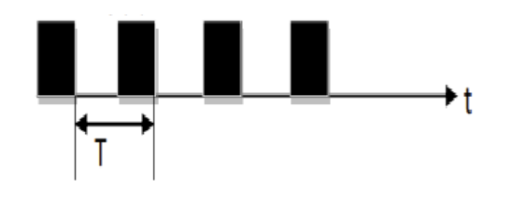
1. Time interval between a Complete Transmission of Consecutive Packets
a) Periodic/ Strongly Periodic
Time interval between two consecutive packets is constant.
E.g. PCM-coded speech used in traditional telephone switching systems. It is also called strongly periodic/ Periodic

Slide 34
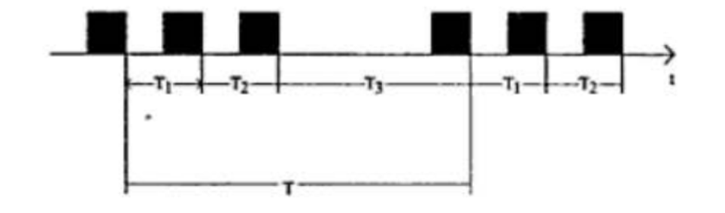
1. Time interval between a Complete Transmission of Consecutive Packets
b) Weakly Periodic
Time interval between the consecutive packets is not constant
Duration of time interval between two consecutive packets can be described by using a periodic function with finite period.
But, time interval between two consecutive packets is not constant.

Slide 35
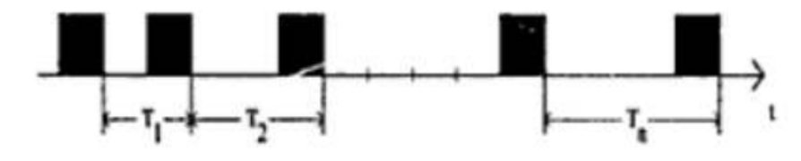
1. Time interval between a Complete Transmission of Consecutive Packets
C) Aperiodic
All possible transmission with respect to time interval are known as aperiodic data streams.
Sequence of the time interval between packets is neither strongly nor weakly periodic.
e.g. Co-operative application with shared Window.

Slide 36
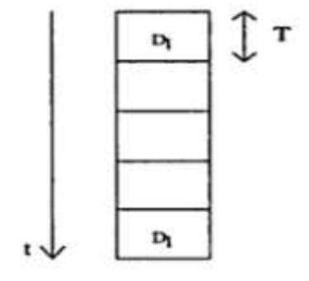
2. Variation of Consecutive Packet Amount
A) Strongly Regular/ Regular
Data size of all the packets is constant.
Amount of the data stays constant during the life time of a data stream
E.g. Uncompressed digital data transmission, video stream taken from a camera in Uncompressed form, CD- Audio Disk

Slide 37
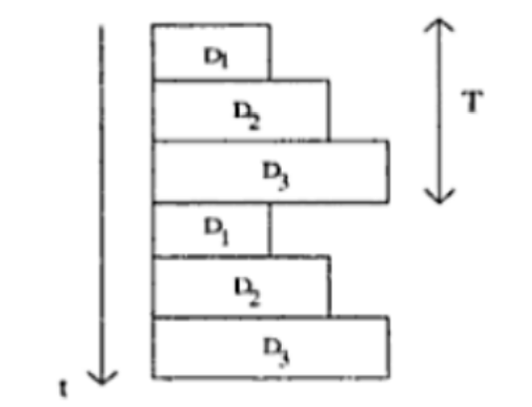
2. Variation of Consecutive Packet Amount
B) Weakly Regular
Data size of the packets changes periodically (with time). E.g. compressed video stream. MPEG compression
Inbetween the packets that are being sent, additional packets will be sent which includes the difference between the two compressed packets that were sent previously.

Slide 38
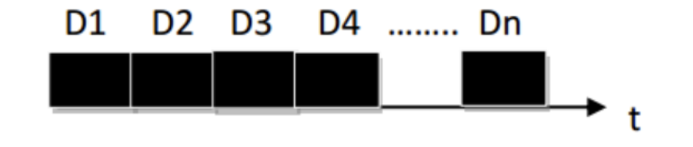
3. Contigious Packets
A) Contiguous Packets
It characterizes continuity, or connection between consecutive packets
All packets are transmitted successively without a gap.
A connected data stream allows maximum data throughput and optimal utilization of system resource.
System Resource is 100% utilized

Slide 39
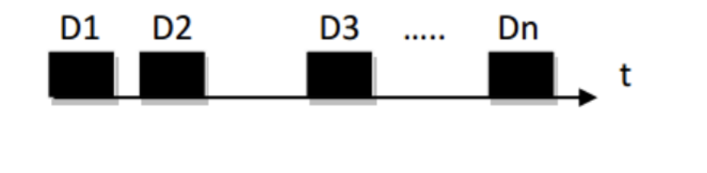
3. Contigious Packets
B) Discrete Packets
Gap exists among the packets. Also called unconnected data stream. Duration of the gap may vary.
Mostly, the transmission of data stream via a channel with higher capacity would sometimes create this gap.
BUT, the size of gap and duration of these gaps is not an issue.

Slide 40
References
Multimedia: Computing, Communications and Applications”, Ralf Steinmetz and Klara Nahrstedt, Pearson Education Asia
“Multimedia Communications, Applications, Networks, protocols ad Standards”, Fred Halsall, Pearson Education Asia
“Multimedia Systems”, John F. Koegel Buford, Pearson Education Asia

Slide 41
Thank you

